Slide 1

ELAN
26 OCTOBRE 2016

Slide 2
ELAN
26 octobre 2016
WHO CAN APPLY AT CALQ ?
WHAT GRANTS and WHEN TO APPLY ?
HOW DOES IT WORKS ?
WHO YOU CAN TALK TO ?

Slide 3

VISION
2017-2018
Le Patin Libre, Vertical Influences

Slide 4
ELIGIBILITY
GRANTS VS SUBSIDIES
Grant programs are for artists (individuals)
Subsidy programs are for non profit organizations

Slide 5
ELIGIBILITY
GENERAL ELIGIBILITY
The applicant must be a Canadian citizen or a landed immigrant as contemplated in section 2(1) of the Immigration and Refugee Protection Act. In both instances they must normally reside in Québec and have resided there for at least the preceding 12 months.
The applicant is a professional artist

Slide 6
ELIGIBILITY
PROFESSIONAL ARTIST
They create work or practise an art on their own account or offer their services for remuneration especially in the fields under the responsibility of CALQ.
They have gained the recognition of their peers.
They disseminate or publicly interpret their works in places and/or contexts recognized by their peers

Slide 7
ELIGIBILITY
GENERAL ELIGIBILITY
Have participated in at least one production outside of his training or subsequent to it, in a professional context recognized by his peers.
If an applicant submits a project in a discipline other than the one in which he normally pursues his career, his project must satisfy the eligibility criteria for the new discipline in which he is applying for a grant.

Slide 8
ELIGIBILITY
TWO CATEGORIES OF ARTISTS
EMERGING ARTIST: The applicant must have a maximum of five years of professional artistic practice at the time of filing the application.
DEVELOPMENT: The applicant must have a minimum of two years of professional artistic practice at the time of filing the application.

Slide 9
ELIGIBILITY
TWO CATEGORIES OF ARTISTS
EMERGING ARTIST: The applicant must have a maximum of five years of professional artistic practice at the time of filing the application.
DEVELOPMENT: The applicant must have a minimum of two years of professional artistic practice at the time of filing the application.

Slide 10
ELIGIBILITY
TWO CATEGORIES OF ARTISTS
EMERGING ARTIST: An applicant cannot submit more than one application per section in the Emerging Artist category in the same fiscal year.
DEVELOPMENT: An applicant can submit no more than five separate applications and can receive a maximum of five grants in any given fiscal year for the CALQ.

Slide 11
ELIGIBILITY
OTHER CONDITIONS
For open applications with no set deadlines, an application must be submitted at least four weeks prior to the project start date to be deemed eligible.
An applicant who has already received financial support under a CALQ grant program, regardless of the section, is obliged to produce a Report on the use of the grant.

Slide 12
ELIGIBILITY
DISCIPLINES
Circus
Multidisciplinary arts
Digital arts
Visual arts
Chanson
Cinema and video
Danse
Literature
Arts and crafts
Music
Architectural research
Theatre

Slide 13
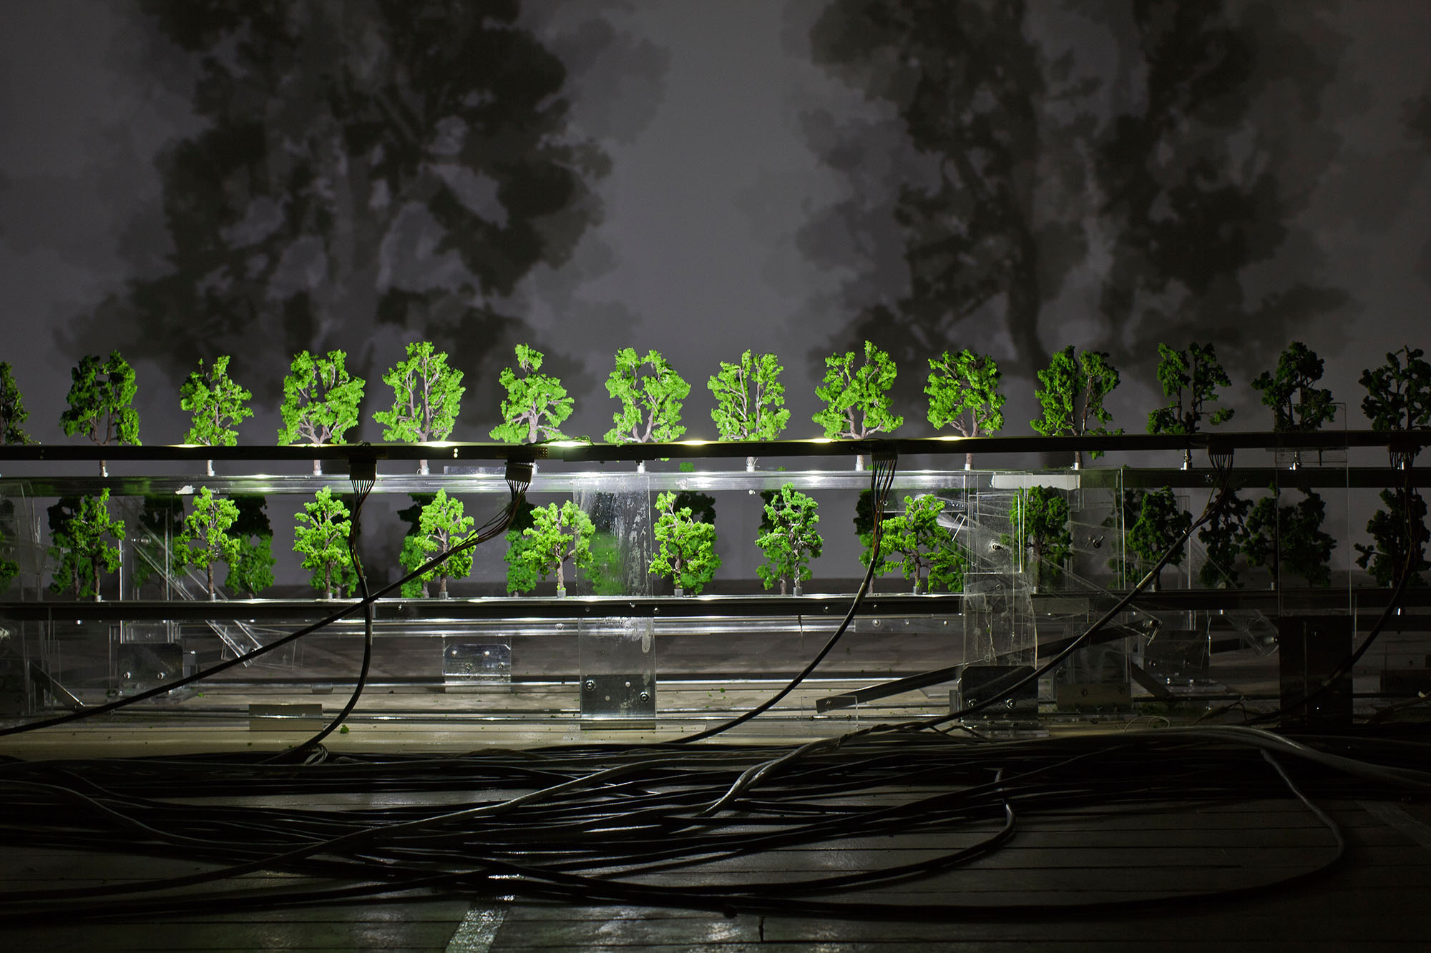
QUAND
Programmes 2017-2018
Photo artiste
Diane Morin, Imbrication

Slide 14
TRAVEL
Application deadline: Anytime
Support for professional artists and writers to travel to accept invitations to participate in activities related to their artistic disciplines or career development.
Maximum allowable amount - determined by the destination

Slide 15
Regular programs
$750: Québec (except Îles-de-la-Madeleine), Ontario and the Maritimes (except Newfoundland)
$1000: Nord du Québec (except Nunavik), Îles-de-la-Madeleine, other provinces of Canada and New England
$2000: Nunavik, United States (except New England), Europe and Mexico
$2500: Africa, Asia, Oceania, Central America, South America

Slide 16
PROFESSIONAL DEVELOPMENT
Application deadline: Anytime
Support for artists to participate in internships, workshops, seminars or conferences to expand their knowledge, invigorate their artistic approach and acquire greater mastery of their art.
Maximum allowable amount – 9’000 $

Slide 17
> ELIGIBLE PROJECTS
Participation as a resource person in workshops or specialized events in or outside Québec
Travel upon an invitation from inside or outside Québec to enable the applicant to present and expand the influence of his artistic work
Travel to engage in a research and creative residency

Slide 18
> ELIGIBLE PROJECTS
Participation as a resource person in workshops or specialized events in or outside Québec
Travel upon an invitation from inside or outside Québec to enable the applicant to present and expand the influence of his artistic work
Travel to engage in a research and creative residency

Slide 19
RESEARCH, CREATION AND EXPLORATION
Application deadline: Anytime (Emerging Artists)
Support for research, creation and exploration intended to help launch an artist’s professional career and foster his integration into professional circles engaged in the arts and literature.
Maximum allowable amount – 15’000 $

Slide 20
RESEARCH AND CREATION
Application deadline: Anytime (Development artists)
Support for research, writing, the creation of works and the realization of projects that nurture the evolution of an artistic or literary approach.
Maximum allowable amount – 25’000 $ | 50’000$

Slide 21
PROMOTION
Application deadline: Anytime (Development artists)
Support for the production of promotional tools to expand an artist’s career or their work’s influence in order to broaden their dissemination network and diversify financing sources.
Maximum allowable amount – 20’000 $
arts and crafts, digital Arts, cinema and video, visual arts

Slide 22
COMMISSIONED WORKS
Application deadline: Anytime
Support for projects realized in collaboration with an organization that commits to contribute to the production and dissemination of an original work, either in the context of a host facility or not.
Maximum allowable amount – 15’000 $
arts and crafts, digital Arts, cinema and video, visual arts, architectural research

Slide 23
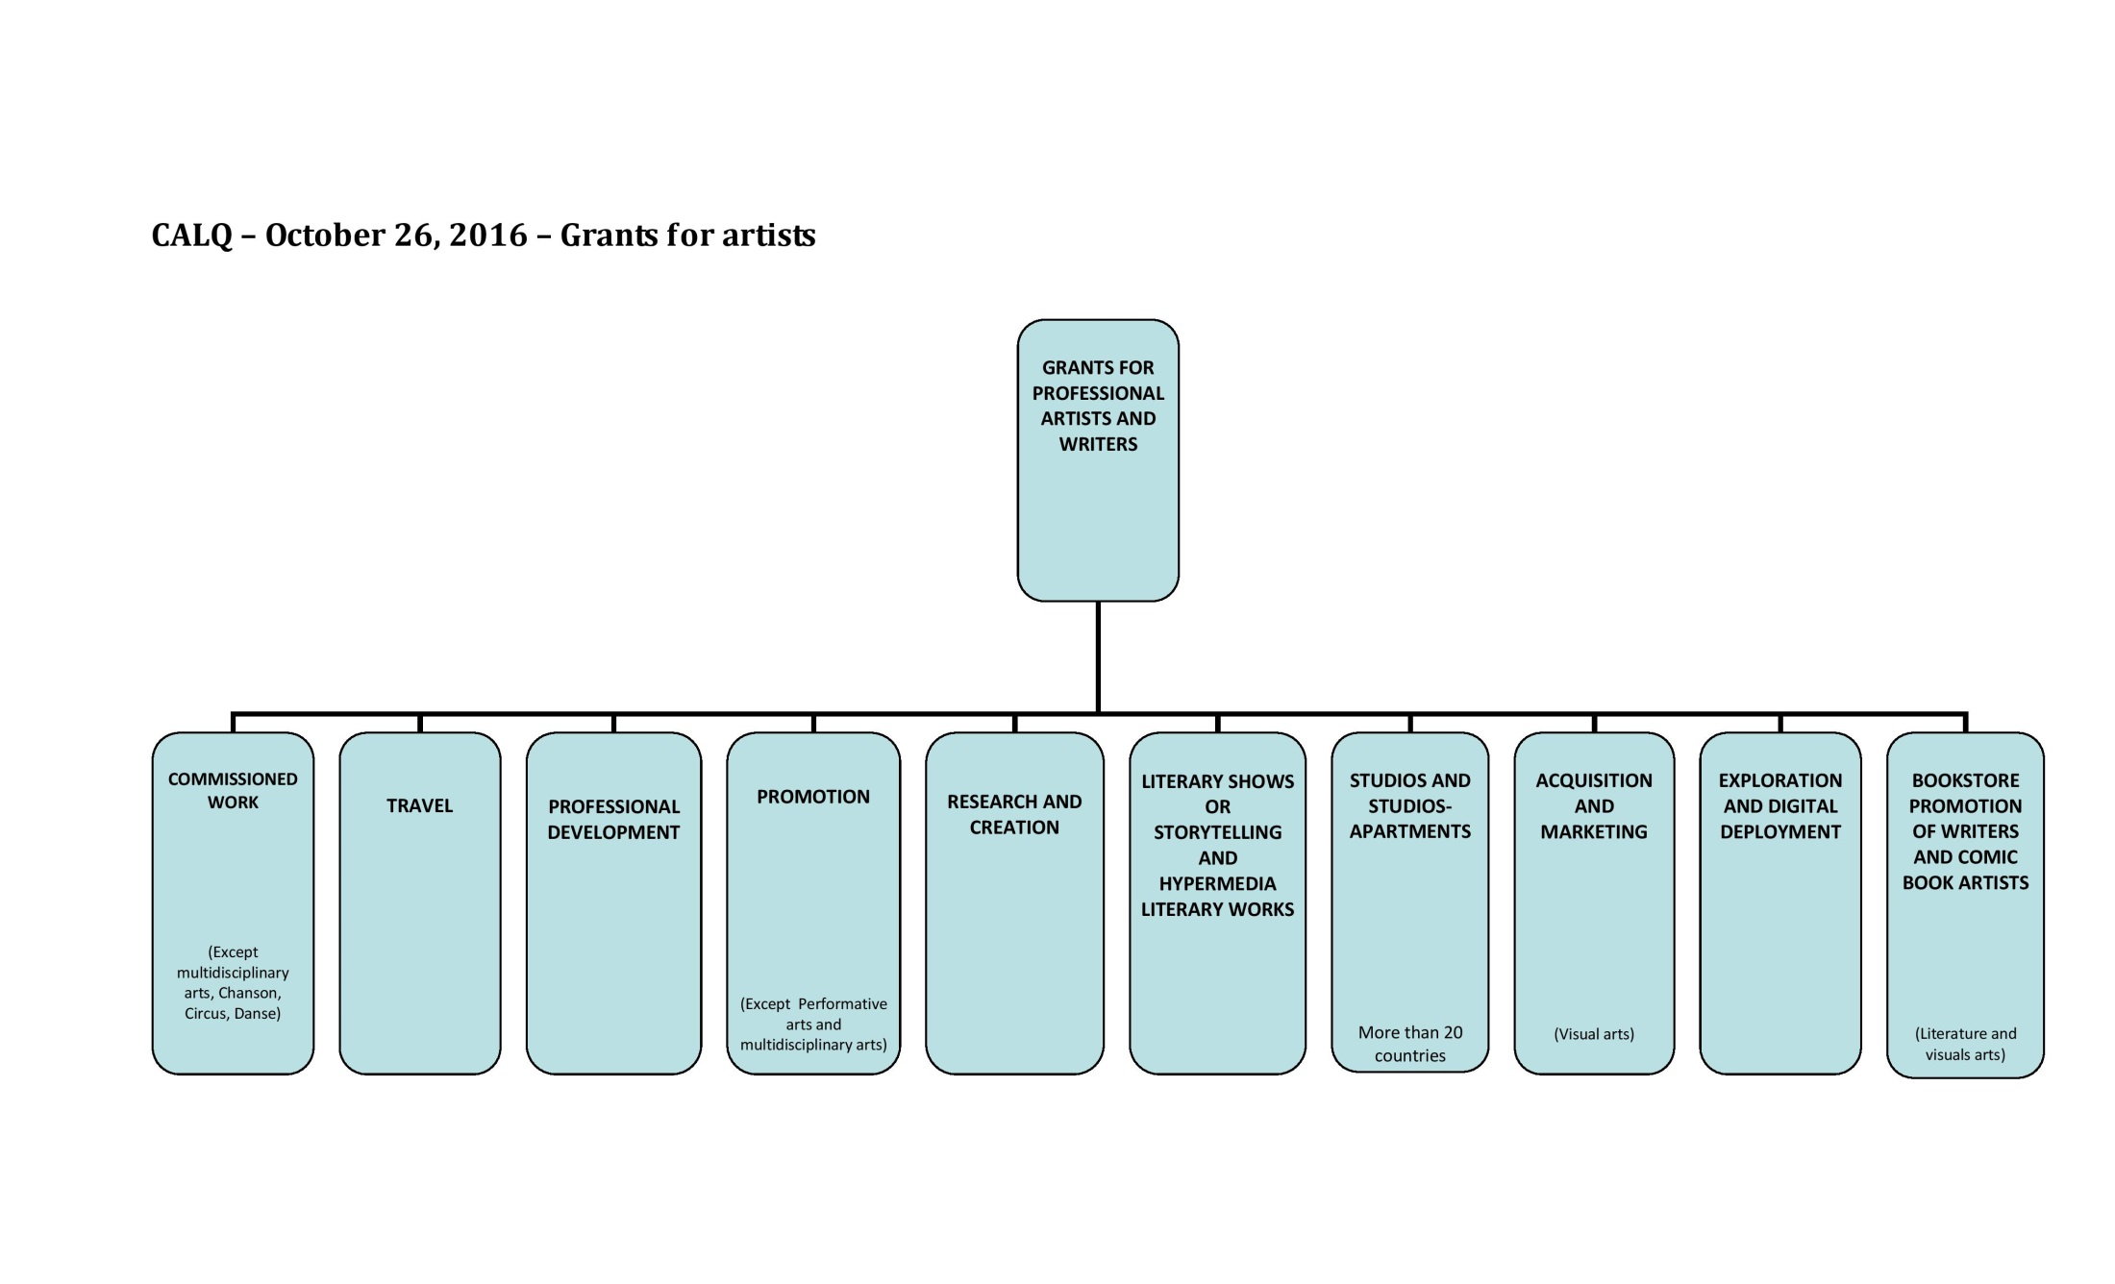

Slide 24


Slide 25

Le Carrousel, Des pieds et des mains

Slide 26
QUAND
How to apply for a grant ?
By mail:
Download form on our website
Online
Mon Dossier CALQ (online)
Grant applications
Report on the use of a grant
Update your personal data

Slide 27
QUAND
THE PROCESS
Filing of applications
Validation of the application
Evaluation of the application by a jury of peers
Decision
Announcement of the results in writing (approximately three (3) months after the date of filing)

Slide 28
QUAND
Applications are evaluated by a jury of peers
A jury of peers must consist of 3 to 5 people, men and women, selected to reflect the diversity of practices, territorial representation, generational representativeness and the ethnocultural diversity of the population.

Slide 29
QUAND
PROGRAM OFFICERS
André Boileau
Music and chanson
418 528-8102 ou 1 800 608-3350
andre.boileau@calq.gouv.qc.ca
Denise Denis
Circus, multidisciplinary arts, danse
514 864-2393 ou 1 800 608-3350
denise.denis@calq.gouv.qc.ca

Slide 30
PROGRAM OFFICERS
Laurent Rozencwajg
Digital arts, cinéma and vidéo
514 873-9821 ou 1 800 608-3350
laurent.rozencwajg@calq.gouv.qc.ca
Guillaume Thériault
Theatre and literature
514 864-7719 ou 1 800 608 3350
guillaume.theriault@calq.gouv.qc.ca

Slide 31
PROGRAM OFFICERS
Marianne Thibeault
the visual arts, the arts and craftsand architectural research
418 528-2582 ou 1 800 608-3350
marianne.thibeault@calq.gouv.qc.ca

